Slide 1

NATURAL DISASTER INTENSITY ANALYSIS AND CLASSIFICATION USING ARTIFICIAL INTELLIGENCE
Team ID:LTVIP2023TMID08241
Submitted by M.Durga Mounika (20NM1A04A1)
N.Tejasree (20NM1A04B4) K Surya Prasanna (20NM1A0478) B.Darshini (20NM1A0431) BACHELOR OF ENGINEERING
IN Electronics and Communication Engineering
VIGNANS INSTITUTE OF ENGINEERING FOR WOMENS

Slide 2
INTRODUCTION PROJECT OVERVIEW:
Natural disasters are large-scale geological or meteorological events that have the potential to cause loss of life or property. A disaster is a result of a natural or man-made hazard impacting a vulnerable community India is one of the most disaster-prone countries in the world. A disaster is a serious disruption of a community or a society involving widespread human ,material ,economic or environmental losses and impacts ,which exceeds the ability of the affected community to cope using its own resources. The locational and geographical features render it vulnerable to a number of natural hazards such as drought ,fire ,landslides and avalanches. Disaster can be caused by naturally occurring events such as earthquake, cyclone ,flood, and wildfires. This will destroy the properties of human societies and even lead to permanent change in the ecosystem. Natural disasters are inevitable but the occurrence of this drastically effects the human-life. To tackle this problem ,this project proposes a AI based disaster management.

Slide 3
PURPOSE:
The purpose of natural disaster intensity analysis and classification using AI is to build a deep learning model that can classify and tell the intensity of a natural disaster based on images. This can help to overcome losses in ecosystems, human lives, and properties by providing timely and accurate information for disaster management and response. Basically the Min objective of natural disaster management reduce the damage. However, there are several on Objectives that are integrated with it. Identifying the hazard and its cause. Reducing vulnerability and potential loses of hazard. Assessing ,reviewing and controlling the risk. Reducing the damage, death, sufferings and destruction of any natural and human induced disaster Giving protection to victims. Increasing the strength among people to survive among disasters .Building up capacity in every sector like-individual, social, economic, environmental, national and international. Ensuring the availability of local emergency equipment and transportation. Promote the culture of disaster risk prevention and mitigation at all levels.

Slide 4
PROBLEM STATEMENT:
Disaster can be caused by natural occurring events such as earthquakes, cyclones , floods and wildfires. Many deep-learning techniques have been applied by various researches to detect natural disasters to overcome losses in ecosystem ,but detection of natural disasters still faces issues due to the complex and imbalanced structures of images. To tackle this problem we process a multi-layered deep convolutional neutral network. A civilian who is aware about natural disasters and takes the prediction methods to save nature. Due to natural disasters ,there are droughts ,economic crisis ,capital destruction etc. Natural disasters are increasing because of population growth , urbanization (a lot of people in small places),alteration of the natural environment(man-made islands).

Slide 5
PROPOSED SOLUTION:
The main purpose of this model is to detect and classify the type of disaster with a high accuracy rate .To prevent natural disasters in the future ,said model can be used to predict future disasters and take some action against heavy loss of human ecological systems and property. We propose a multi-layered deep convolution neural network .The proposed model works in two blocks: Block-1 convolutional neural network (B-1 CNN), for detection and occurrence of disasters. block-2 convolutional neural network (B-1 CNN), for classification of natural disasters intensity type with different filters and parameters. Building collapse , ailments spread and sometimes natural disasters such as tsunamis can devastate nations. The proposed multi-layered deep convolutional neural network was simulated on the computer system with core i7 ,central processing.

Slide 6
REQUIREMENT ANALYSIS: 1.FUNCTIONAL REQUIREMENT
We will discuss sub requirements of the functional requirements:
1.LOGIN-Login by giving a mobile number, g-mail or google account and their location on.
2.ALERT-The alert message is given to all the users when the cyclone hits.
3.MONITORING-Continuous monitoring of cyclones and climate changes.
4.REPORTS-Keeping the records of the previous cyclone and refer news from meteorologist for live updates.
5.END USERS-The information is sent to the farmers using the database.
6.END GOAL-Inform farmers about the cyclone and its intensity.

Slide 7
2.NON-FUNCTIONAL REQUIREMENET:
The following are the non-functional requirements of the proposed solution :
1.USABILITY-While using this system, people turn on their current location on. They receive alert messages as no fica on. The local officials can also inform and guide their nearby people and farmers by an alert message.
2.SECURITY-It does not share any personal information on to strangers.
3.RELIABILITY-As the details collected from satellite image and meteorologist and updated details in this system, so it is trustworthy.
4.PERFOMANCE-It runs in minimum storage space. It will run efficiently when 1000 users login the same time.
5.AVAILABILTY:It should be available in all Android phones and laptops. 6.SCALABILITY-As the product we created is user friendly and it will be very useful for farmers and agriculture.

Slide 8
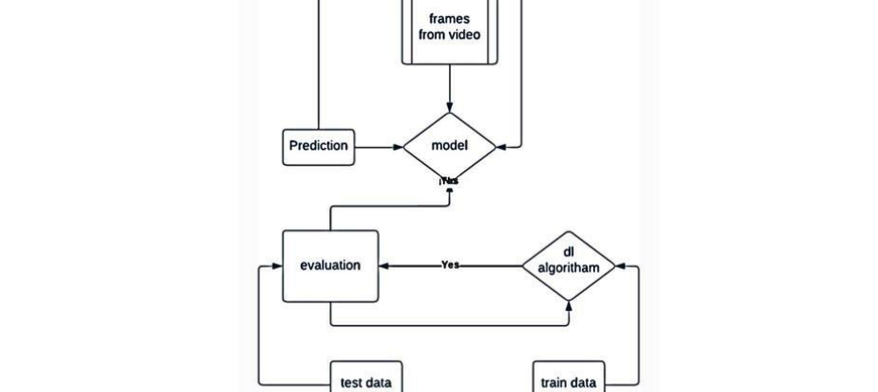
PROJECT DESIGN- DATA FLOW DIAGRAM
A data-flow diagram is a way of representing a flow of data through a process or a system. The DFD also provides information about the outputs and inputs of each entity and the process itself.

Slide 9
FUNCTIONAL REQUIREMENTS AND USER STORIES:
A user story is an informal, general explanation of a software feature written from the perspective of the end user or customer. The purpose of a user story is to articulate how a piece of work will deliver a particular value back to the customer.
1.LOGIN-As a farmer, I can login by giving mobile number, g-mail or google account and their location.
2.ALERT-As a farmer, I can receive the alert message when the cyclone hits.
3.MONITORING-As a farmer, I can view the continuous monitoring of cyclone and climatic changes.
4.REPORTS-As a farmer, I can keep the records of the previous cyclone and refer news from meteorologist for live up-dation.
5.END USERS-As a farmer, I can receive the information from the database.

Slide 10
SOLUTION AND TECHNICAL ARCHITECTURE:
SOLUTION ARCHITECTURE:A solution architecture (SA) is an architectural description of a specific solution. SAs combine guidance from different enterprise architecture viewpoints (business, information and technical), as well as from the enterprise solution architecture (ESA).
TECHNOLOGY STACK:A tech stack is the combination of technologies a company uses to build and run an application or project. Sometimes called a “solutions stack,” a tech stack typically consists of programming languages, frameworks, a database, front-end tools, back-end tools, and applications connected via APIs.

Slide 11
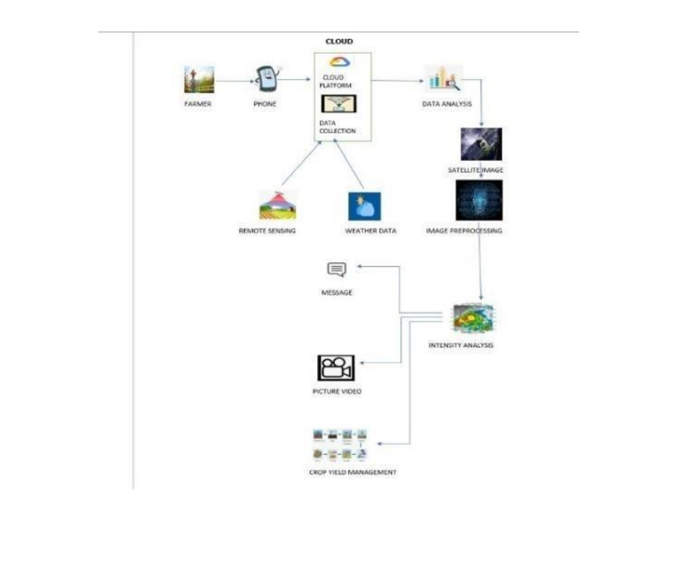
TECHNOLOGY STACK:

Slide 12
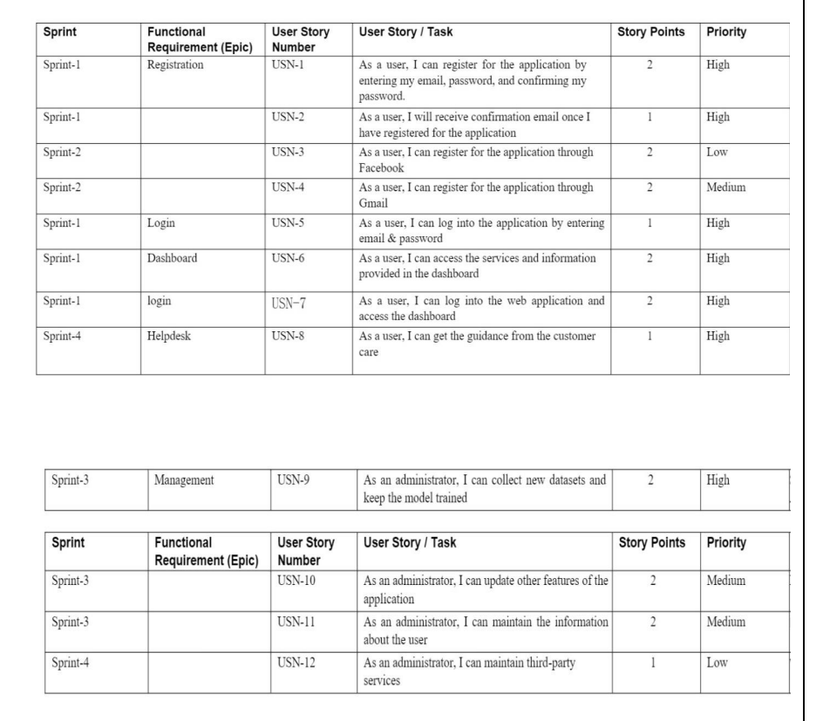
PROJECT PLANNING AND SCHEDULING: SPRINT PLANNING AND SCHEDULING

Slide 13
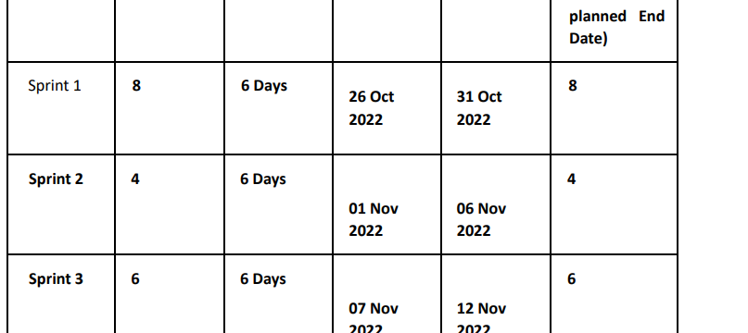
SPRINT DELIVERY SCHEDULE:

Slide 14
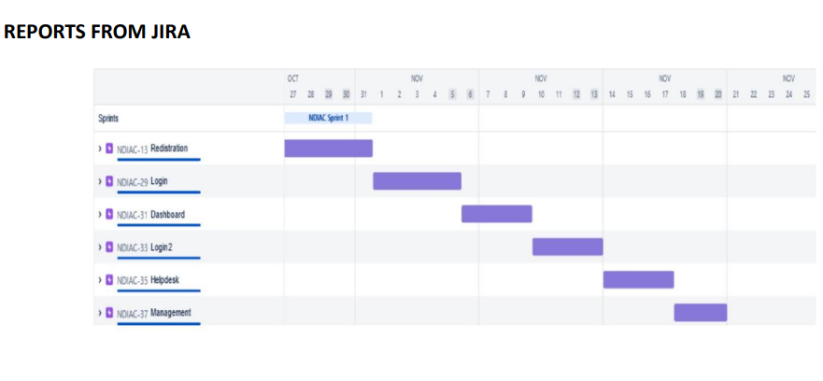
REPORTS FROM JIRA:

Slide 15
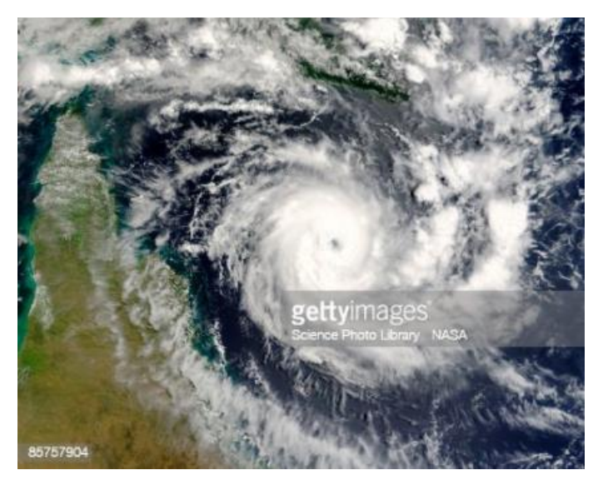
IMAGES OF NATURAL DISASTERS:
CYCLONE:
Tropical cyclones are one of the biggest threats to life and property even in the formative stages of their development. They include a number of different hazards that can individually cause significant impacts on life and property, such as storm surge, flooding, extreme winds, tornadoes and lighting. Combined, these hazards interact with one another and substantially increase the potential for loss of life and material damage.

Slide 16
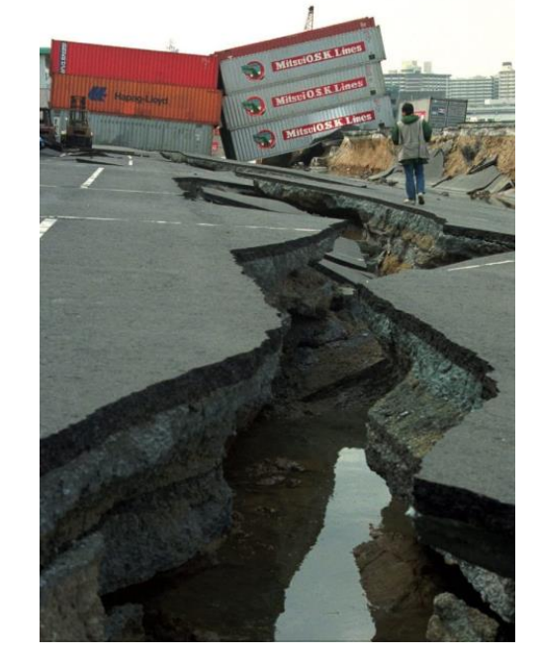
EARTHQUAKE:
Earthquakes occur most often along geologic faults, narrow zones where rock masses move in relation to one another. The major fault lines of the world are located at the fringes of the huge tectonic plates that make up Earth’s crust.

Slide 17
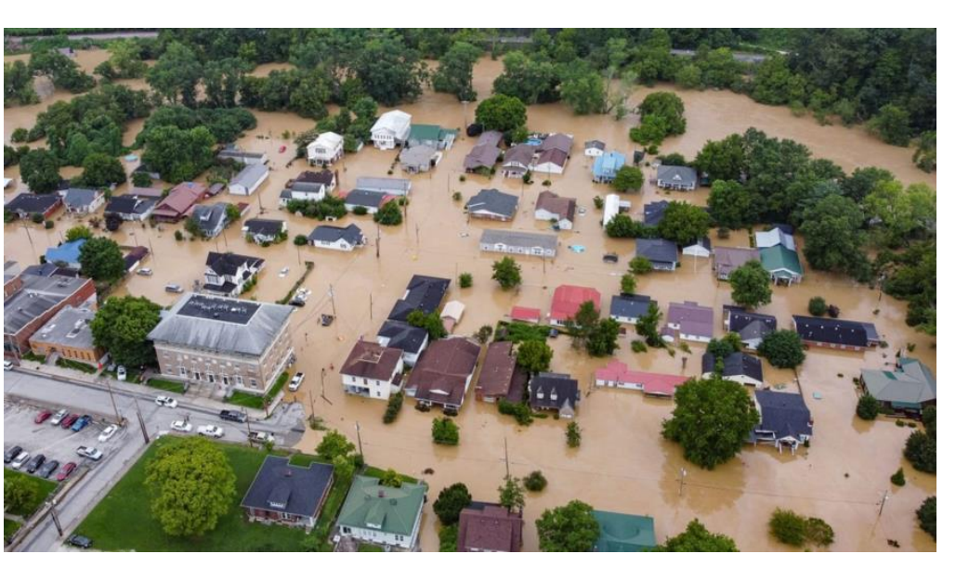
FLOODS:
Floods are a type of natural disaster that can cause heavy destruction to life and property. It is a condition when rainwater accumulates at a place, flooding populated areas. They can also lead to the loss of numerous lives. At times, it can be highly dangerous and can wipe off an entire village or city.

Slide 18
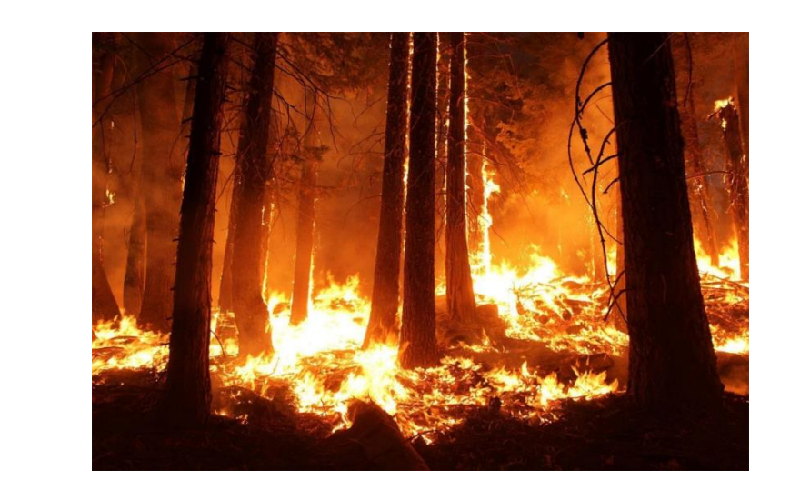
WILDFIRE:
Wildfires occur when vegetated areas are set alight and are particularly common during hot and dry periods. They can occur in forests, grasslands, brush and deserts, and with sufficient wind can rapidly spread. Unchecked, such fires can cause devastation to forests and other areas of vegetation

Slide 19
CODING AND SOLUTIONING:
FEATURE 1-A convolutional neural network is a class of artificial neural networks. It is a deep learning algorithm that can be take in an input image, assign importance to various objects in the image and be able to differentiate one from the other. The pre-processing required in a convnet is much lower as compared to other classification algorithms.
The advantage of CNN is to provide an efficient dense network which performs the prediction or identification efficiency.
FEATURE 2-We developed a multilayered deep convolutional neural network model that classifies the natural disaster and tells the intensity of disaster of natural. The model uses an integrated webcam to capture the video frame and the video frame is compared with the pre-trained model and the type of disaster is identified and showcased on the open cv window. A multilayer neural network with appropriate weights has been shown to be able to approximate any input –output function making it an attractive tool for modeling and forecasting.

Slide 20
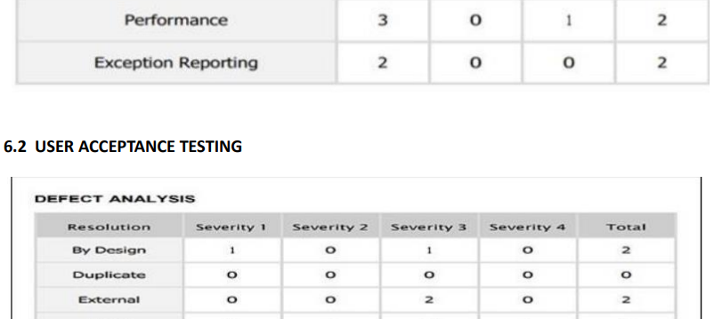
TESTING:

Slide 21
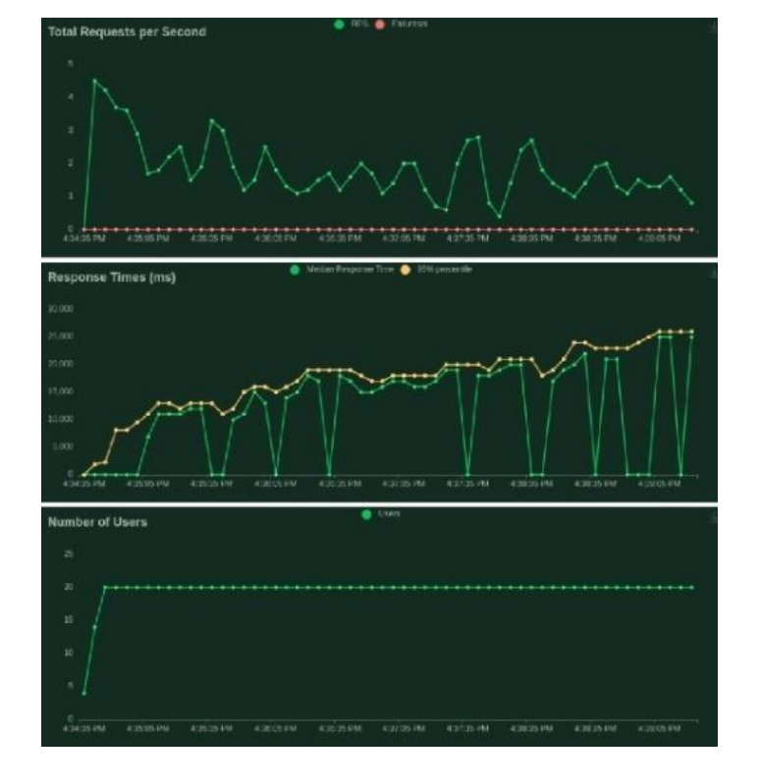
RESULTS:

Slide 22
ADVANTAGES AND DISADVANTAGES: ADVANTAGES:
1.Humans also need breaks and time offs to balance their work life and personal life. But A I can work endlessly without breaks.
2. With the use of various AI based techniques, we can also anticipate today’s weather and the days ahead.
3. Helpful in getting life back on track.
4. Their Alert nature able to respond effectively and efficiently which defend the
society from large scale damages.

Slide 23
DISADVANTAGES:
1.It involves huge money to be equipped.
2. Problems faced in life basic needs.
3. One application of artificial intelligence is a robot, which is displacing occupations and increasing unemployment .
4. Machines can perform only those tasks which they are designed or programmed to do, anything out of that they tend to crash or give irrelevant outputs which could be a major backdrop.

Slide 24
CONCLUSION:
Artificial intelligence has the potential to enhance the detection and classification of natural disasters, as well as the resilience and relief efforts of affected communities. By using deep learning techniques, AI can analyze complex and imbalanced images of disasters and provide accurate and timely information. However, AI also faces challenges such as data quality, ethical issues, and human-AI collaboration. Therefore, it is essential to develop robust and reliable AI systems that can complement human expertise and judgment in disaster management.
AI can help predict the occurrence and impact of natural disasters by using historical data, satellite imagery, and weather models. This can enable early warning systems and preparedness plans for vulnerable areas. AI can also assist in the recovery and reconstruction of disaster-affected regions by providing insights into the needs and priorities of the survivors, as well as the best allocation of resources and funds. AI can also support the learning and improvement of disaster management practices by analyzing the lessons learned from past disasters and identifying the gaps and opportunities for future interventions.

Slide 25
FUTURE SCOPE:
To develop more advanced and efficient deep learning models that can handle the complexity and diversity of natural disaster images, and provide accurate and reliable results. To integrate multiple sources and types of data, such as text, audio, video, and sensor data, to enhance the analysis and classification of natural disasters and their impacts. To explore the ethical and social implications of using AI for natural disaster management, such as the privacy, security, and accountability of the data and the algorithms, and the potential biases and risks of the AI outputs. To evaluate the performance and impact of AI for natural disaster management, and compare it with other methods and tools, such as human experts, traditional models, and manual processes. To foster the collaboration and communication among different stakeholders, such as researchers, practitioners, policymakers, and communities, to share the best practices and challenges of using AI for natural disaster management, and to co-create solutions that meet the needs and expectations of the users. To promote the awareness and education of the public and the decision-makers on the benefits and limitations of AI for natural disaster management, and to encourage the participation and feedback of the affected people and groups.

Slide 26
THANK YOU

